Slide 1

3811 CORPORATE ROAD, P.O. BOX 1838,
PETERSBURG, VA 23805
(804)862-9889 PHONE
(804) 861-8816 FAX

Slide 2


Spices
Ground Black Pepper
Most common grind is the 32 Mesh Standard. Others include the 24 Mesh Table grind, 18 Mesh Chef’s Choice, Butcher’s, Fine Ground, and 10 Mesh cracked.
Ground Red Pepper
Most commonly ordered as Cayenne (30MHU) or Standard (15MHU)
Other spices include but are not limited to:
Ground White Pepper
Crushed Red Pepper
Onion and Garlic
Paprika
Basil, Oregano, Parsley
Thyme, Rosemary
Ground Cumin
Sesame, celery, and poppy seed

Slide 3

Seasonings and Blends
Cajun Seasoning
Herbs and spices with onion, garlic, and red pepper
Seasoning Salt
Unique blend of salt and spices
Chef Larry’s Seasoning Salt
Blend of salt, spices, FD&C approved colors, and a hint of sweetness
Mobjack Bay
Seafood seasoning with no MSG. May contain nutmeg.
Canadian Seasoning
Intense blend of herbs and spices
Crab Boil (Also comes as vibrant Red or Hot and Spicy)
A pungent blend of spices and salt
Taco Seasoning
Unique blend of herbs and spices with onion and garlic
Chicken Seasoning
Unique blend of salt and spices
Italian Seasoning
Oregano blended with spices and red pepper
Greek Italian Seasoning
Blend of sugar and spices used as a dressing
Chili Powder
Blend of peppers and spices
Curry Powder
Indian style blend of herbs and spices

Slide 4


Chicken Breading
All Purpose
Southern Fried Chicken Breading
Seasoned blend of wheat and corn flours
Dixie Deli Chicken Breading (Original Southern Fried Recipe with less salt)
Mildly seasoned blend of wheat and corn flours
Deep Fry Breading
Seasoned blend of wheat flour and milk
Chicken Batter
Seasoned blend of wheat flour with egg, milk, and garlic note
Mild to Medium
Mild Cajun Breading
Seasoned blend of wheat flour with a hint of cayenne
Medium Spicy Chicken Breading
Spicy blend of wheat and corn flours with a hint of sweetness
Zesty Chicken Breading
Spicy blend of wheat and corn flours with egg and a hint of sweetness
Chuckie’s Breading
Spicy blend of wheat and corn flours with soy based flavorings
Hot & Spicy
Hot Cajun Breading
Spiciest blend of wheat flour and red peppers
Hot Cajun Breading No MSG
Original spiciest blend of wheat flour and red peppers without MSG

Slide 5

Seafood Breading
Fish Breading
Seasoned blend of wheat flour and cracker
Seafood Breading No MSG
Seasoned blend of wheat flour and cracker without MSG
Seafood/ Oyster Breading
Blend of wheat and corn flours with egg and hint of garlic
Dixie Deli Seafood Breading (Original recipe with less salt)
Mildly seasoned blend of wheat flour and cracker
Other Breading, Batters, & Mixes
Veggie Breading
Seasoned blend of wheat and corn flours with egg
Tempura
All purpose Japanese style coating
Pancake and Waffle Mix
Specially blended to make golden deliciousness
Hushpuppy Mix
Wheat and corn flours with egg, dairy whey, onion, and a hint of sweetness
Brown Gravy Mix
Savory with a hint of onion
BBQ Sauce Mix
Sweet and tangy or spicy and smoky

Slide 6
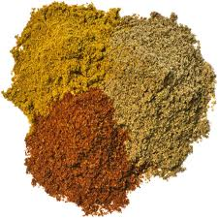
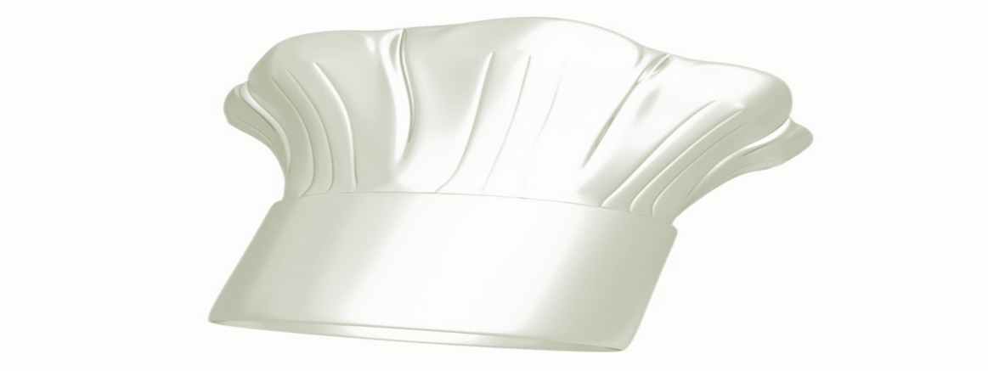
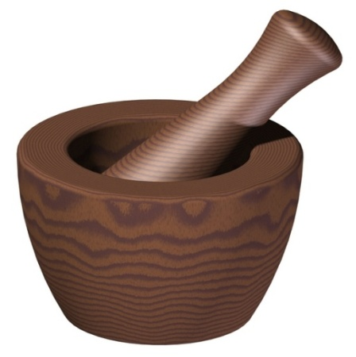
Custom Blending
Rubs, marinades, gravies, salad dressing and sauce bases, batters, breading's and seasonings
Experienced In-house research Chef
Ideal for high volume restaurants or multi-unit operators
Distinguish yourself with unique and proprietary products using your label
Develop your product from recipe or concept with direct access
Various packaging options
Reasonable start-up minimums starting at 500lbs
Separates your restaurant from the ordinary
Meets the functional application you need and gives you that one of a kind unique home-style or intense flavor you can’t forget!

Slide 7
Typical Packaging
Chef Jars
(6 to a case) approximately 1lb each
Jugs
(4 to a case) up to 5lbs
Standard Spice Rounds
(12 per box or 24 per tray) approximately 5.5oz
Ranch Jars
(6 per box) approximately 8.4oz
Small Bulk
Liner (white), form fill film pouch, or heat sealed bag (clear) in box
Large Bulk
Liner (white) bag in box or white paper seal bag (each) up to 50lbs
All master cases (box) are white corrugated
Fill rates vary per bulk index
Old Mansion or Private and Graphics Master Case and Piece labels are Available
Please See Your Sales Representative for More Details to Fit Your Needs or
Contact us @ 1 (800) 476-1877
Any order over 1,000 lbs. qualifies for free shipping

Slide 8

The product you want and the service you require.
For more information on any of our products or packaging options please feel free to contact your local Sales Representative.
For inquiries visit: www.oldmansion.com
Thank you for your time and interest.
P.O. BOX 1838, PETERSBURG, VA 23805
(804)862-9889 PHONE or 1 (800) 476-1877

